Slide 1
“Taiwan Woman” (1983) Medoruma Shun (1960-)
魚群記
目取真俊

Slide 2

Medoruma Shun
Born in Nakijin, Motobu Peninsula, near Nago in northern Okinawa
Graduate of the University of the Ryukyus, Japanese literature
1983 debut, “Taiwan Woman”
1997 Akutagawa Prize, “Droplets”
Activist/Writer
Blog: https://blog.goo.ne.jp/awamori777

Slide 3
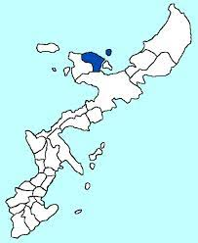
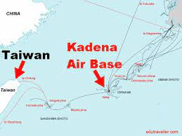
Maps of Okinawa (Nakijin, L; Taiwan, R)

Slide 4
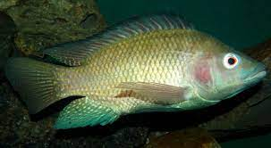
Tilapia
Notes:
Invasive species from Africa originally; need warm water but can survive in less than ideal conditions

Slide 5
Keywords
Reversion, economy
Tilapia
Banyan tree
Koza Riot
Ôe Kenzaburô, “Prizestock” (small village in NE Okinawa, far from bases)
Nakagami Kenji, William Faulkner

Slide 6
Discussion Questions
What makes this story so memorable?
How would you categorize the story? Is it similar to others we have discussed?
What does the eye of the tilapia symbolize?
Why does the story include mention of a bamboo cut Masashi receives? What happens at the end of the story?

